Slide 1
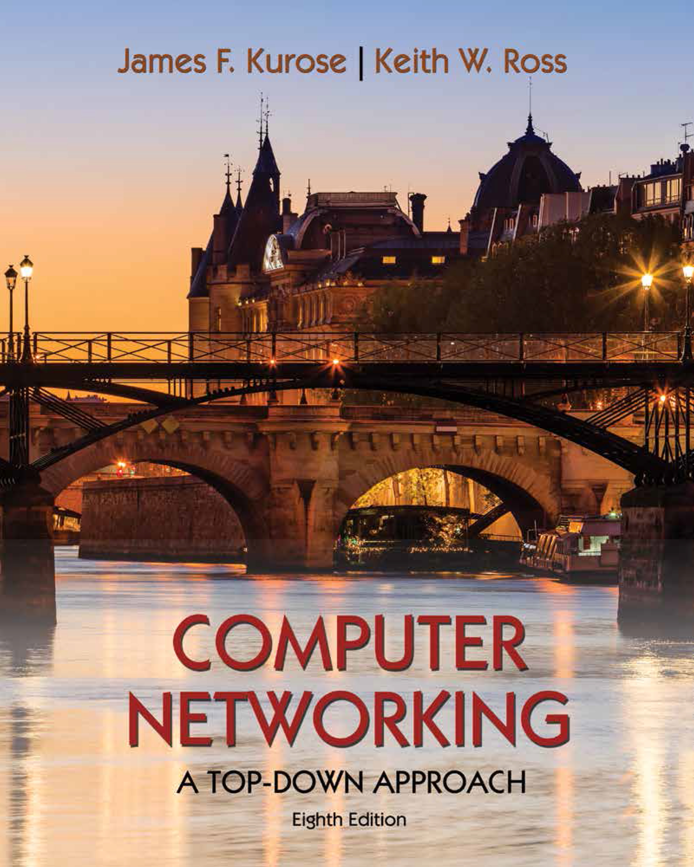
Network Layer: Control Plane
Computer Networks
Introduction: network-layer control plane
Routing algorithms
Intra-ISP routing: OSPF
routing among ISPs: BGP
SDN control plane
Internet Control Message Protocol
Network management

Slide 2
Network layer control plane: our goals
understand principles behind network control plane:
traditional routing algorithms
SDN controllers
network management, configuration

Slide 3
Network layer control plane: our goals
understand principles behind network control plane:
traditional routing algorithms
SDN controllers
network management, configuration
instantiation, implementation in the Internet:
OSPF, BGP
OpenFlow, ODL and ONOS controllers
Internet Control Message Protocol: ICMP
SNMP, YANG/NETCONF

Slide 4
Network layer: “control plane” roadmap
introduction
routing algorithms
link state
distance vector
intra-ISP routing: OSPF
routing among ISPs: BGP
SDN control plane
Internet Control Message Protocol

Slide 5
Network layer: “control plane” roadmap
introduction
routing algorithms
link state
distance vector
intra-ISP routing: OSPF
routing among ISPs: BGP
SDN control plane
Internet Control Message Protocol
network management, configuration
SNMP
NETCONF/YANG

Slide 6
Network-layer functions
routing: determine route taken by packets from source to destination
control plane
forwarding: move packets from router’s input to appropriate router output
data plane
Two approaches to structuring network control plane:
per-router control (traditional)
logically centralized control (software defined networking)

Slide 7

Per-router control plane
Individual routing algorithm components in each and every router interact in the control plane
Routing
Algorithm
control
plane
data
plane
values in arriving
packet header
0111
1
3
2

Slide 8
Software-Defined Networking (SDN) control plane
Remote controller computes, installs forwarding tables in routers
Remote Controller
control
plane
data
plane
CA
CA
CA
CA
CA
values in arriving
packet header
0111
1
3
2

Slide 9
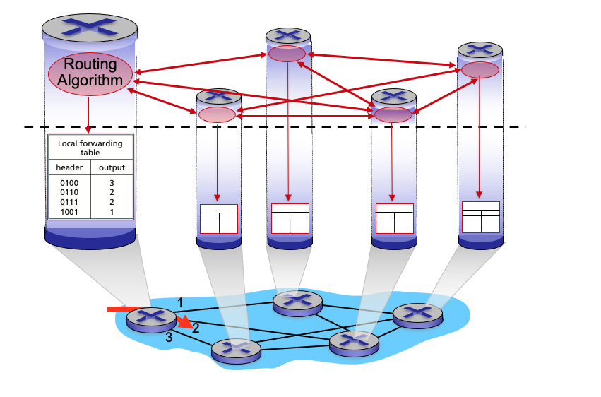
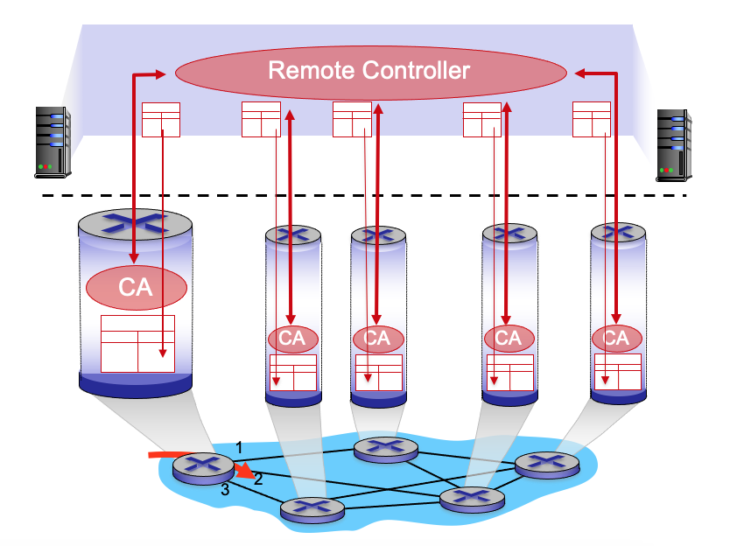
Per-router control plane
SDN control plane

Slide 10
Routing Versus Forwarding
Which of the following statements correctly identify the differences between routing and forwarding. Select one or more statements.
Forwarding refers to moving packets from a router’s input to appropriate router output, and is implemented in the control plane.
Forwarding refers to determining the route taken by packets from source to destination, and is implemented in the control plane
Routing refers to moving packets from a router’s input to appropriate router output, and is implemented in the data plane.
Routing refers to moving packets from a router’s input to appropriate router output, and is implemented in the control plane.
Routing refers to determining the route taken by packets from source to destination, and is implemented in the data plane
Forwarding refers to determining the route taken by packets from source to destination, and is implemented in the data plane.
Forwarding refers to moving packets from a router’s input to appropriate router output, and is implemented in the data plane.
Routing refers to determining the route taken by packets from source to destination, and is implemented in the control plane.

Slide 11
Control Plan Implementation Approaches
Write the name of the approach towards implementing a control plane considering the given description that how the approach works.
A (typically) remote controller gathers information from routers, and then computes and installs the forwarding tables in routers.
Software-defined networking (SDN)
Individual routing algorithm components - with a component operating in each and every router - interact with each other in the control plane. The individual routing algorithm component executing in a given router computes the local forwarding table for that router.
Per-router control plane

